Slide 1
European Quality of Life Survey 2007
(UKDS: SN 6299)

Slide 2
Teachers need ready-to-use files requiring little or no further preparation. Students may only have one semester of classes and lab sessions. Researchers need to factor in budgets, time, opportunity costs etc. All need to be up and running in the very first session. Criteria for ease of understanding and (immediate) use of SPSS files:
Full and clear documentation, including (facsimile) questionnaire
SPSS saved files well designed and easy to navigate
Names and/or variable labels easily linked to questionnaire
Variables in questionnaire order, not alphabetical order
Variable and value labels short but clear
Value labels to include question number, unless it is the variable name
Value labels in Mixed Case and literate
Missing values correctly and consistently assigned and declared
Measurement levels correctly assigned

Slide 3
Report

Slide 4
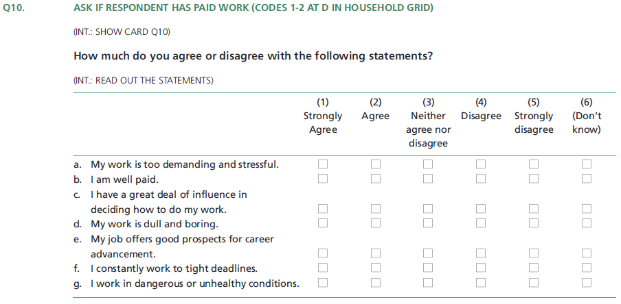
Printed questionnaire (Appendix in report)

Slide 5
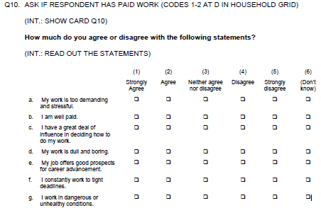
pdf in UKDS documentation
(also contains Questionnaire translated into all languages used)

Slide 6
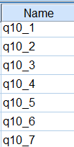
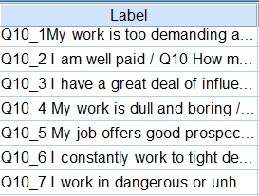
1: Question number is also variable name
2: Question number repeated at beginning of variable label

Slide 7
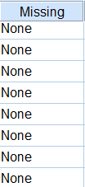
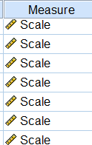
No missing values specified
Measurement levels all Scale

Slide 8
Good points:
1: Variable names tally with question numbers
2: Variable labels have question numbers at beginning.
This means duplication if SPSS set to display both names and labels, but means dialog boxes always display question number if SPSS set to display only one of these.
Pedantic/aesthetic points:
1: Some (derived) integer variables still have 2 decimal places.
2: Variable labels far too long.

Slide 9
Response rate 58% UK 33.5% !!!
N = 35,634 N = 1507
364 variables

Slide 10
Bad points (apart from abysmal response rate):
1: Age is coded in groups at hh2b [I was about to issue a fatwah for the
culprits, but later found the full range of original ages in CVhh2b.]
2: Most variable levels are declared as Scale, a few Nominal, but many of these
are Ordinal. All statistical indices declared as Nominal, but they are actually
single statistical values, even the ones declared as strings.
3: Ridiculously long variable names and variable labels: OK for publication
quality tables, but cumbersome to work with
4: System missing values everywhere, but very few user-missing values declared.
5: Coding system for DK, INAP, Refused completely inconsistent.

Slide 11
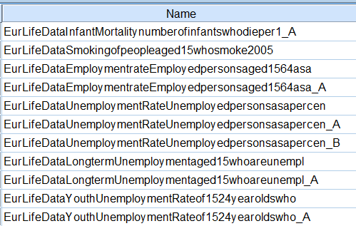
Ridiculously long variable names

Slide 12
Ridiculously long variable labels

Slide 13
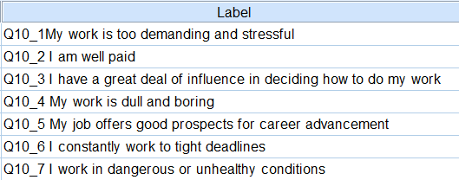
Shorter labels better
Could be improved with a colon and double space after Q.*_*
Q10_1: My work is too demanding and stressful

Slide 14
Needs additional SPSS syntax to specify:
variable levels
missing values
formats (for integers with superfluous decimals)

Slide 15
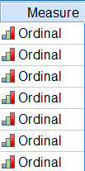

Slide 16
[Live demo here]

Slide 17
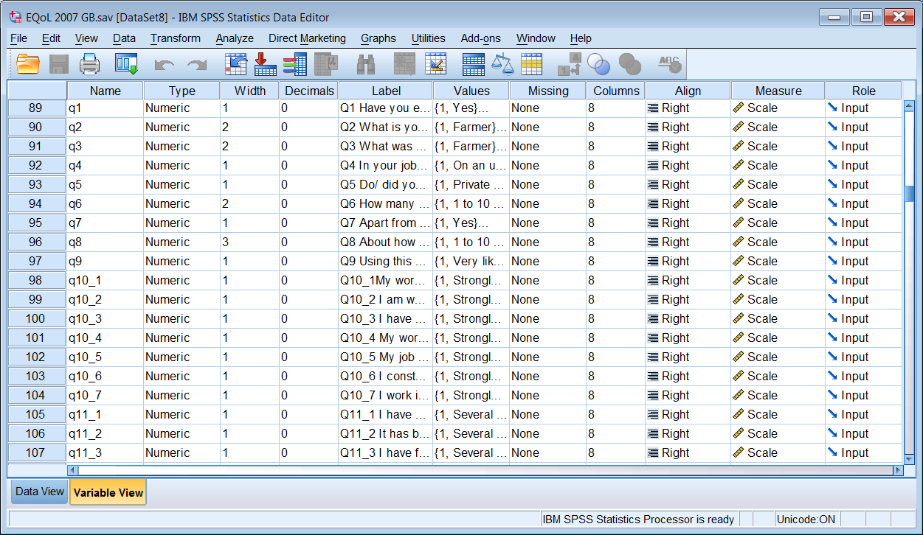
I also prefer to re-arrange the variable attribute columns

Slide 18
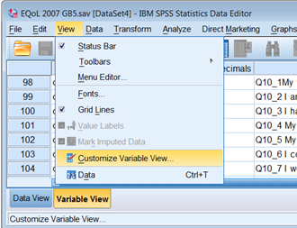

Slide 19
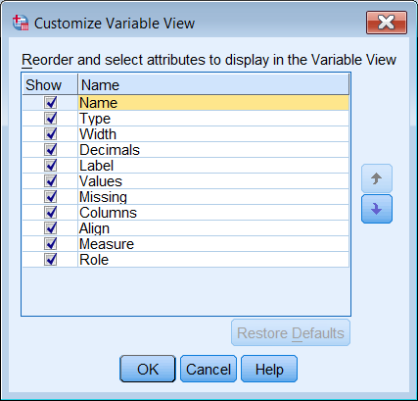
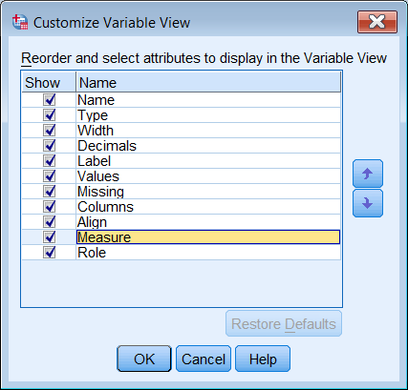

Slide 20
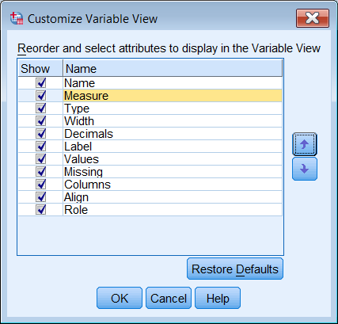
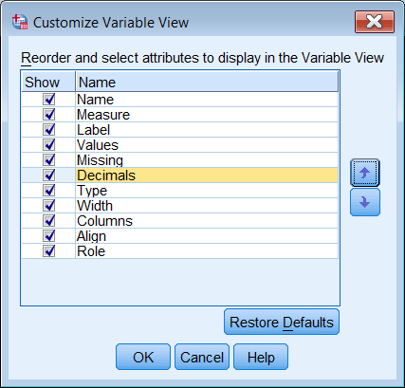

Slide 21
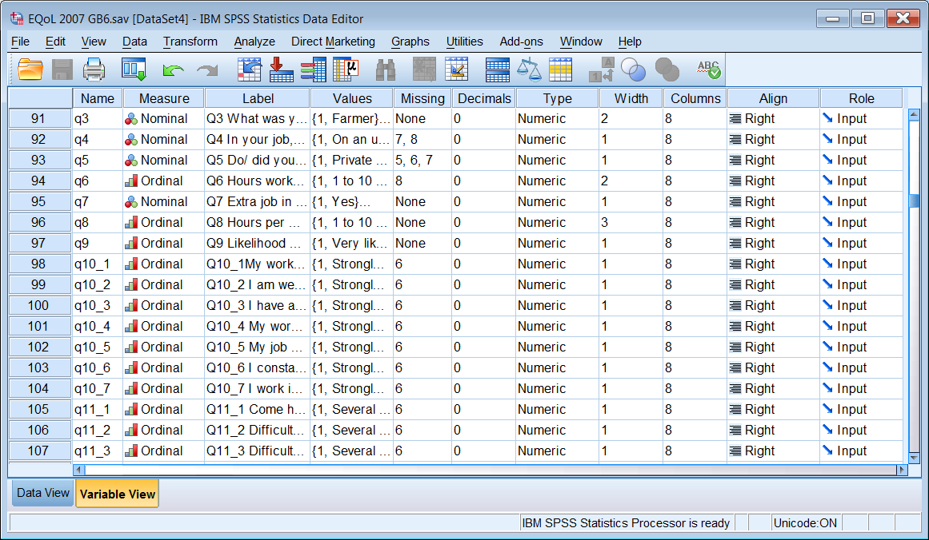
. . to bring the more important ones to the left
This can also be done by highlighting the column header and dragging the whole column left or right across the Data Editor

Slide 22
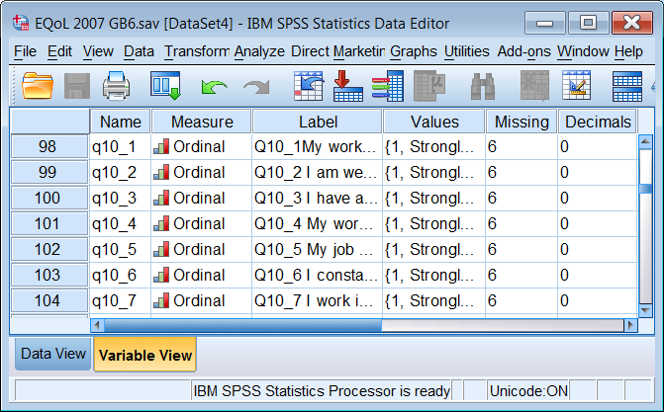
You don’t really need half of them, so drag the right edge in

Slide 23
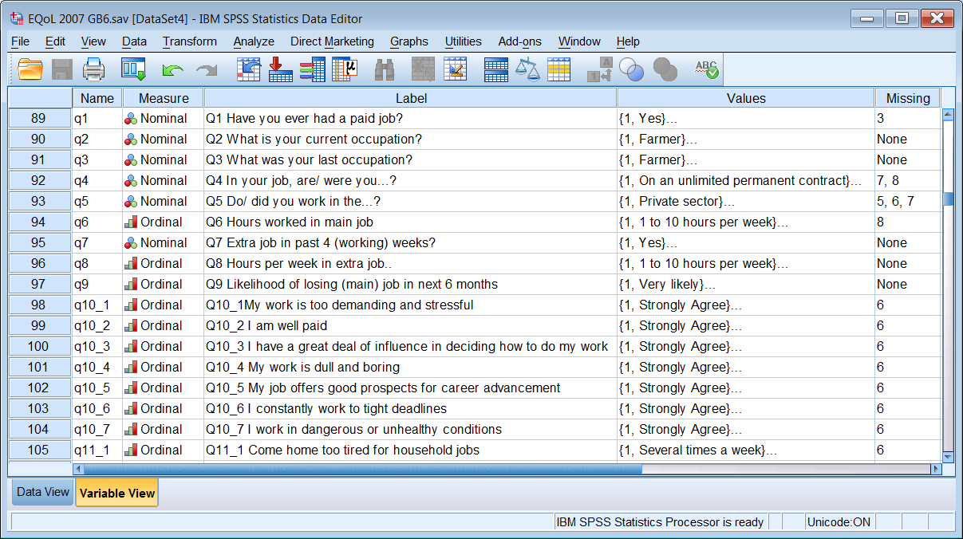
All I really need appears in this window:

Slide 24
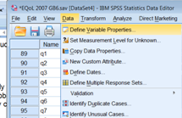
I can check everything using

Slide 25
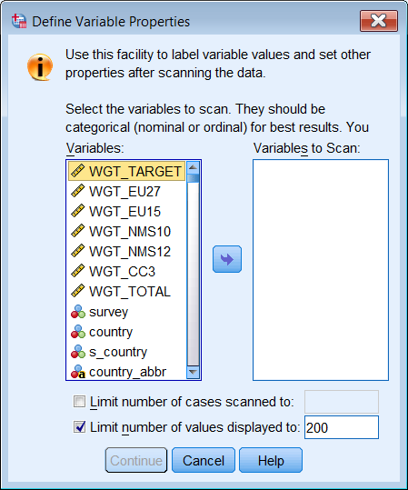
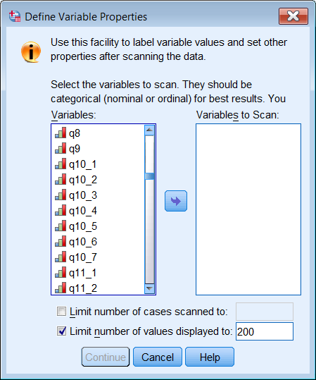
Opening window
Scroll down to find variables

Slide 26
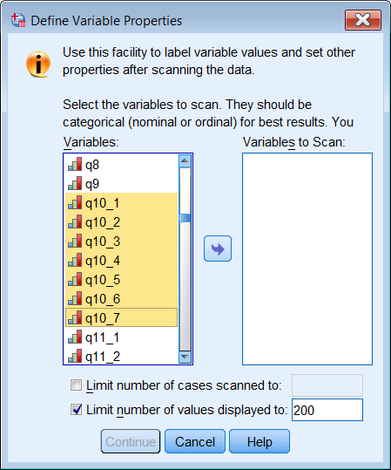
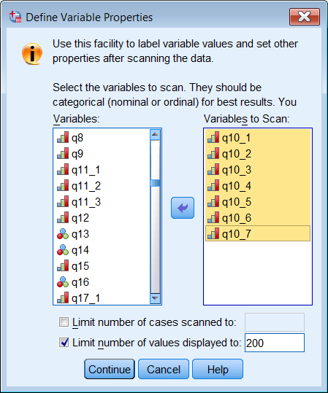
Highlight variables you want
Click on
to transfer to other pane
Click on

Slide 27
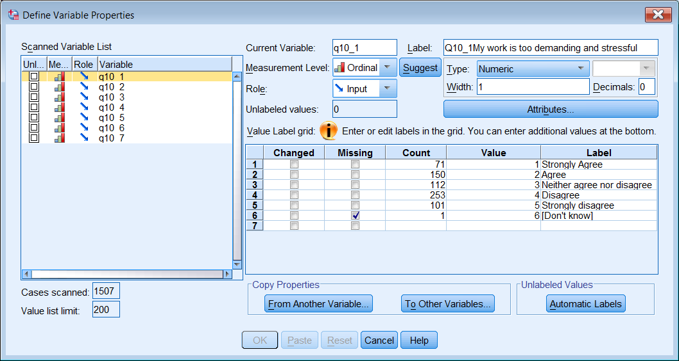
All current information for the highlighted variable is displayed, including a count for each value encountered
Any editing generates syntax which can be saved using

Slide 28
Now for something more complex:

Slide 29
3: Understanding Society 2010
Previously the British Household Panel Survey
Institute for Social and Economic Research (ISER)
(University of Essex)

