Slide 1
3: Understanding Society 2010
Previously the British Household Panel Survey
Institute for Social and Economic Research (ISER)
(University of Essex)

Slide 2
Understanding Society 2010
Understanding Society (website)
Understanding Society (waves 1-3, 2009-2012) [UKDS: SN 6614]
Commentary on Understanding Society 2010

Slide 3
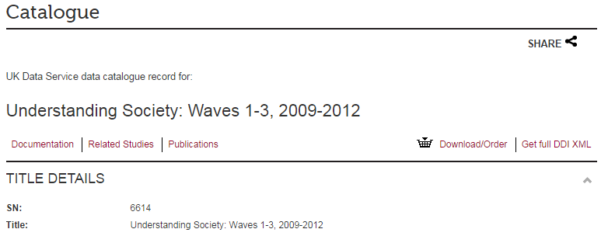
Understanding Society (UKDS: SN 6614 )

Slide 4
Understanding Society (UKDS: SN 6614 )

Slide 5
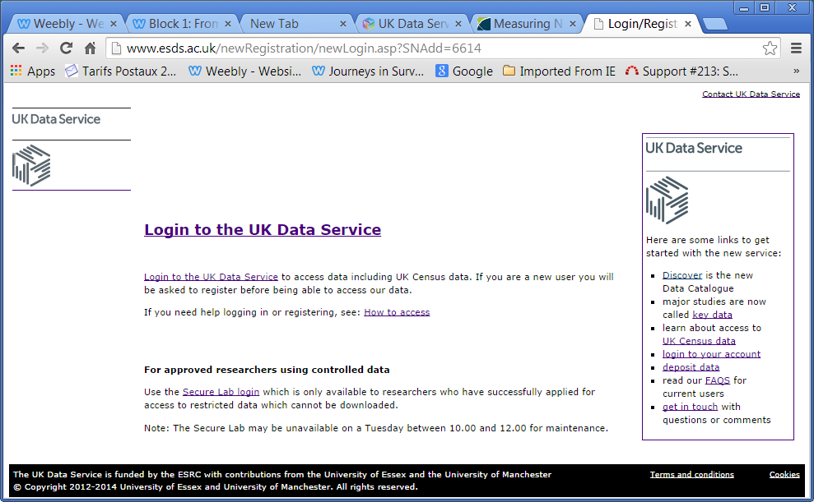

Slide 6
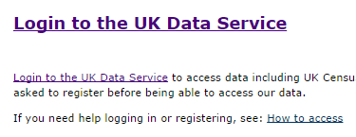

Slide 7
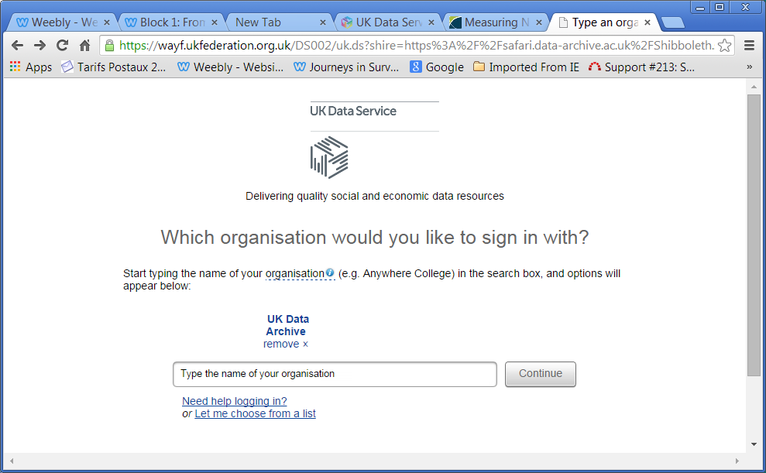

Slide 8
I have no institutional affiliation, so I’m registered as a private non-commercial user via UK Data Archive
Click on UK Data
Archive

Slide 9
UKDS recognises my I.P. address, displays my username with a masked password and logs me in automatically when I click

Slide 10
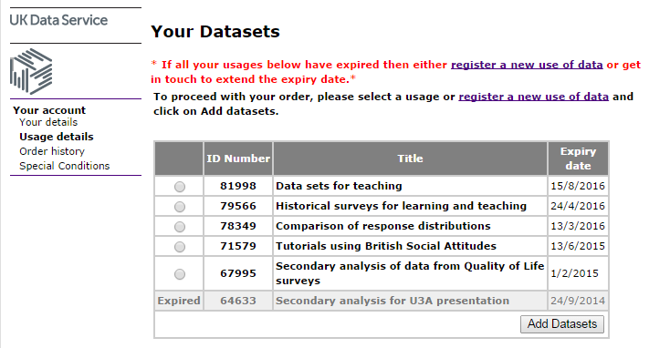

Slide 11
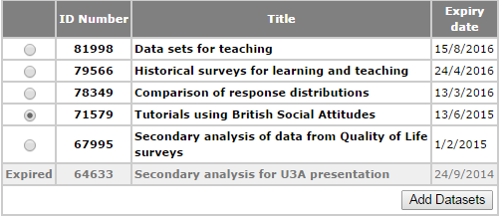
Click a button to select a usage, then click on
in box in top left corner

Slide 12
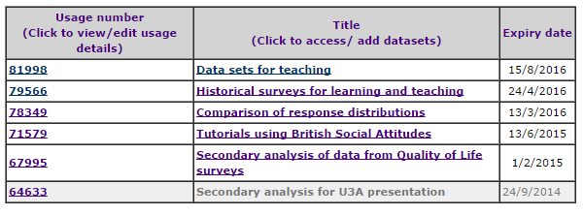
Usage number and Title become live links
Click on Tutorials using British Social Attitudes to display list of data sets for that usage:

Slide 13
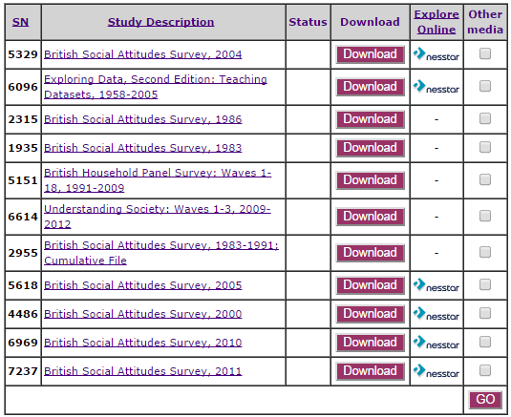

Slide 14
Click on
Click on

Slide 15
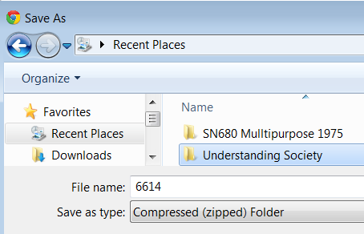

Slide 16
[Live demo here?]

Slide 17
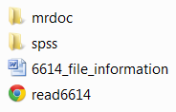
SN 6614: Contents of zip file
→ →
→ →
→ →

Slide 18
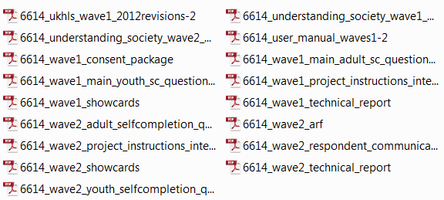
SN 6614: Contents of
17 pdf files:

Slide 19
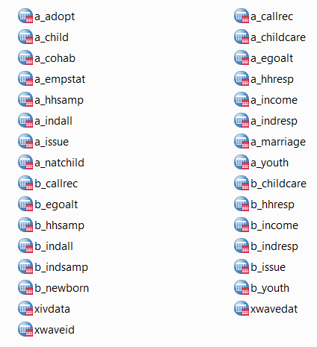
SN 6614: Contents of
(31 *.sav files)

Slide 20
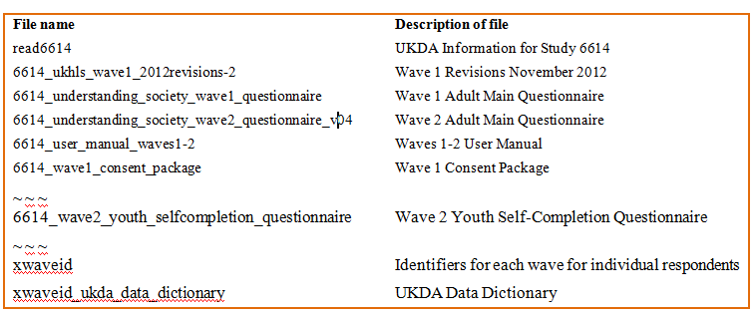
1 x guide to contents 6614_file_information (Word doc in table format: read only)

Slide 21
Understanding Society 2010
31 SPSS *.sav files
Means 31 data dictionaries to examine !!
1 x guide to contents
Contains 17 User Manuals and therefore
17 questionnaires.

Slide 22
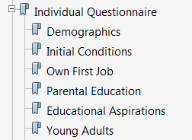
The pdf files are massive, but with live links to dozens of sections

Slide 24
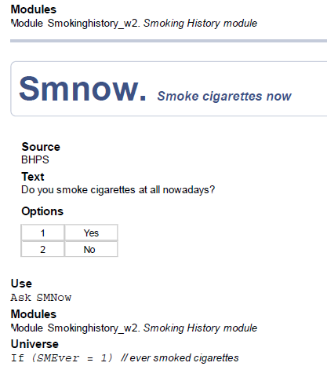

Slide 25
All the information needed for analysis is there, but with no printed questionnaire to work from, beginners (and many teachers) will understandably find it difficult to work from the pdf CAPI version.
A pseudo-printed version could be produced from the CAPI file, but would be a daunting, tedious and time-consuming task

Slide 26
Sample question from adult self-completion questionnaire
Note: variable name super-imposed in red
(Does not appear on questionnaire for respondent)

Slide 27
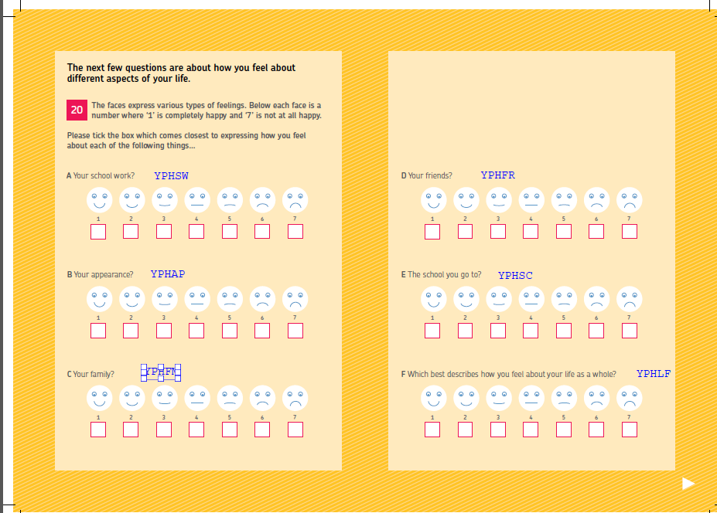
Beautifully designed interactive youth questionnaire
(NB: variable names super-imposed in blue are not displayed to respondent)

Slide 28
Good points:
Missing values are negative and consistently labelled.
Problem points:
Measurement levels all Unknown (but this may well be due to automatic processing at UKDS)
Most variable and value labels start with lower case letters
No question numbers at all (to use with questionnaire?)

Slide 29
Next show
4: British Social Attitudes

