Slide 1
Epilogue
British Social Attitudes 2004
NORC General Social Survey 2008
ONS Well‐Being Modules 2011
European Social Survey 2012/13
plus a couple of surveys from the distant past . .
Relative Deprivation and Social Justice 1962 (complete restoration from 1975 files)
SSRC Multi-purpose Survey 1975

Slide 2
British Social Attitudes 2004
Book:
Exploring Data (2nd edition, Polity Press, 2008)
by Cathie Marsh and Jane Elliott
Notes on Exploring Data (JFH)
Website:
Exploring Data
Data:
Exploring Data Teaching Datasets (UKDS: SN 6096)
Commentary:
Commentary on Teaching Datasets

Slide 3
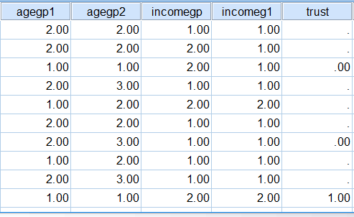
Default format for derived variables is (f8.2)

Slide 4
* Define Variable Properties.
*agegp1.
FORMATS agegp1(F8.0).
*agegp2.
FORMATS agegp2(F8.0).
*incomegp.
FORMATS incomegp(F8.0).
*incomeg1.
FORMATS incomeg1(F8.0).
*trust.
FORMATS trust(F8.0).
*volgp.
FORMATS volgp(F8.0).
*volgp1.
FORMATS volgp1(F8.0).
*qual1.
FORMATS qual1(F8.0).
*qual2.
FORMATS qual2(F8.0).
EXECUTE.
Using DVP and PASTE to change these produces the following syntax:

Slide 5
So much easier (and quicker) to write:
formats agegp to qual2 (f2.0).
See also Appendix:
Changing SPSS settings for the Data Editor

Slide 6
NORC General Social Survey (GSS) 2008
Commentary on full NORC General Social Survey 2008
Commentary on subset of General Social Survey 2008
as used by Sweet and Grace-Martin Data Analysis with SPSS: A First Course in Applied Statistics (4th Edition, Pearson, 2012)
Commentary on GSS 2008 SPSS files for Babbie et al
as used by Babbie, Halley, Wagner & Zaino
Adventures in Social Research: Data Analysis Using IBM SPSS Statistics (8th edition, Sage 2013))

Slide 7
The NORC file for GSS 2008 has variables in alphabetical order and the only questionnaire is the CAPI version. Program Director Tom Smith says there is never a text version. Creating one would be a mammoth task.
A version with variables in questionnaire order can be created by downloading the raw data and a syntax file from SDA at Berkeley. Both NORC and SDA versions have all labels in UPPER CASE.
Sub-sets of GSS 2008 are used by Babbie et al (alphabetical order) and by Sweet and Grace-Martin (questionnaire order) but both have all variable and value labels in UPPER CASE.
None of the above have question numbers in the labels.

Slide 8
Commentary on full NORC General Social Survey 2008
First encounter with GSS2008.SAV1
“Here's what I tend to do with new-to-me SPSS saved files the first time I open them. The file GSS2008.SAV arrived from the Roper Center in a zip file”
Commentary includes examples of:
Syntax from PASTE when using Define Variable Properties
Python code to change case of labels
CTRL+H to substitute strings in Values column

Slide 9
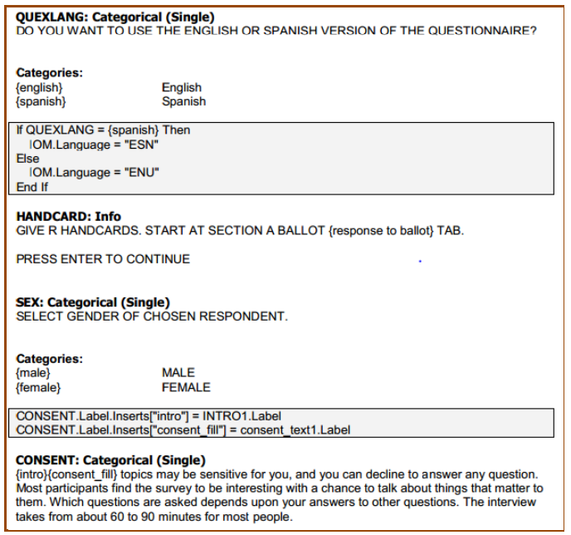

Slide 10
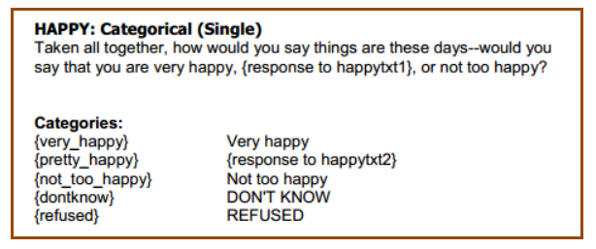
As an example, take a question that has been asked in one form or another for decades in GSS and other surveys:
Taking all things together, how would you say you are these days? Would you say you are very happy, pretty happy or not too happy these days?

Slide 11
/*Changes all letters to lower case.
begin program.
import spss, spssaux
vardict = spssaux.VariableDict()
for var in vardict:
var.VariableLabel = var.VariableLabel.lower()
vallabels = var.ValueLabels
for k,v in vallabels.items():
if not v in ['IAP', 'DK', 'NA']:
vallabels[k] = v.lower()
var.ValueLabels = vallabels
end program.

Slide 12
/*Restores first letter of first word to upper case
begin program.
import spss, spssaux
vd = spssaux.VariableDict()
for v in vd:
varlabel = v.VariableLabel
if varlabel:
v.VariableLabel = varlabel.capitalize()
vallbls = v.ValueLabels
for k in vallbls:
vallbls[k] = vallbls[k].capitalize()
if vallbls:
v.ValueLabels = vallbls
end program.

Slide 13
* This program capitalizes all variable and value labels and
replaces words listed in the uppercase variable with their
all-caps equivalent in variable and value labels.
begin program.
import spss, spssaux, re
# terms to capitalize as free-standing words - list in uppper case
# or whatever case variant is desired
uppercase = ["IAP", "DK", "NA"]
vd = spssaux.VariableDict()
for v in vd:
varlabel = v.VariableLabel
if varlabel:
varlabel = varlabel.capitalize()
for w in uppercase:
sexpr = r"(?i)\b%s\b" % w
varlabel = re.sub(sexpr, w, varlabel)
v.VariableLabel = varlabel
vallbls = v.ValueLabels
for k in vallbls:
vallbls[k] = vallbls[k].capitalize()
for w in uppercase:
sexpr = r"(?i)\b%s\b" % w
vallbls[k] = re.sub(sexpr, w, vallbls[k])
if vallbls:
v.ValueLabels = vallbls
end program.

Slide 14
ONS Opinions Survey, Well‐Being Modules
SN 6893: Well‐Being Modules April-Sep 2011
SN 7146: Unrestricted Access Teaching Dataset
(April 2011 wave only)
Commentary
Introduction and Commentary: Unrestricted Access Teaching Dataset

Slide 15
Uses same variable names in all surveys, but, turning the whole concept on its head, the variable names are also the question numbers:
MCZ_1 to 4
These are subjective wellbeing questions which are also running on the IHS. These questions are randomised so that respondents will be asked the 4 questions in 1 of 4 different orders.
MCZ_5 - 7
Subjective wellbeing questions asking about different areas of peoples’ lives.

Slide 16
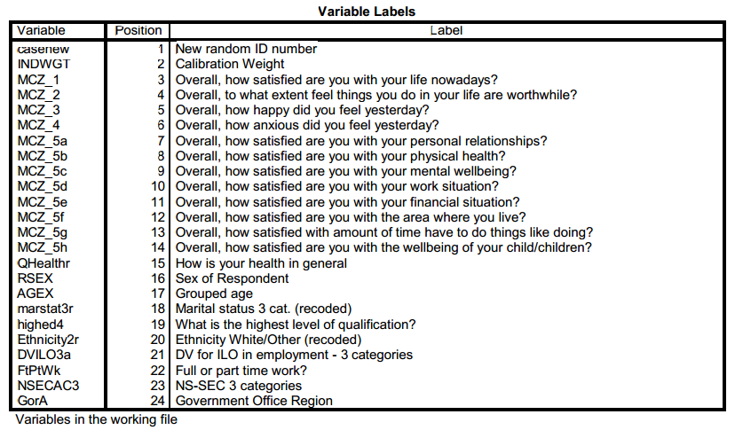

Slide 17
First impressions
Missing values correctly declared and labelled
Variables casenew qhealthr marstat3r Ethnicity2r are all integer, but have two superfluous decimal places.
Suspect measurement levels (despite Ordinal for qhealthr and agex).
Suspect levels also in the userguide from CCSR Manchester, in which 0-10 scales are treated as Scalar (originally done with Stata?) when strictly speaking they are Ordinal as are other variables such as highed4 (highest education qualification) and nsecac3 (occupational social class).
Some labels inordinately long. As usual with SPSS you can't see the full labels without widening the Label and Values columns.
No question numbers, but with such a small data set it's easy to work out what the variables are if you drag the Label margin to the right:

Slide 18
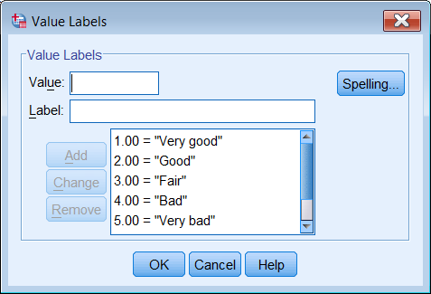
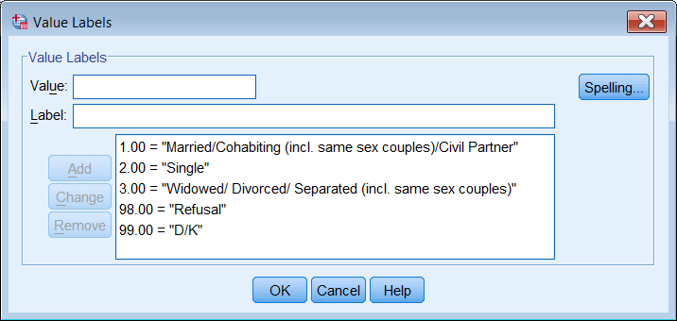
Superfluous
decimal places

Slide 19
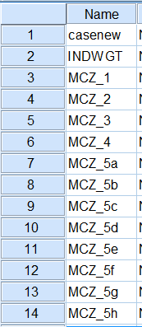
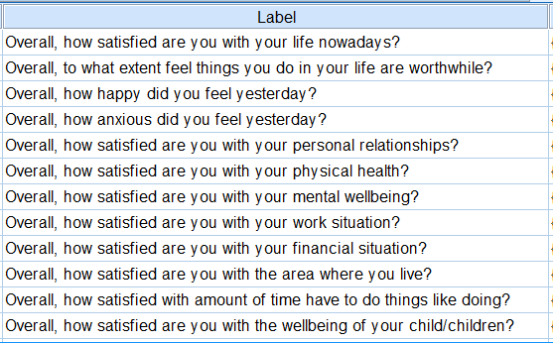
Question numbers constant across waves:
used as variable names, but do not appear in labels

Slide 20
European Social Survey
The data from all surveys are available without restrictions, for not-for-profit purposes.

Slide 21
SPSS files for waves 1 -6 (GB only)
File | Variables | Cases
ESS1GB.sav (2002) | 565 | 2052
ESS2GB.sav (2004) | 603 | 1897
ESS3GB.sav (2006) | 517 | 2286
ESS4GB.sav (2008) | 662 | 2352
ESS5GB.sav (2010) | 662 | 2422
ESS6GB.sav (2012) | 586 | 2286
The question numbers are not the same in each survey, but the variable names are.

Slide 22
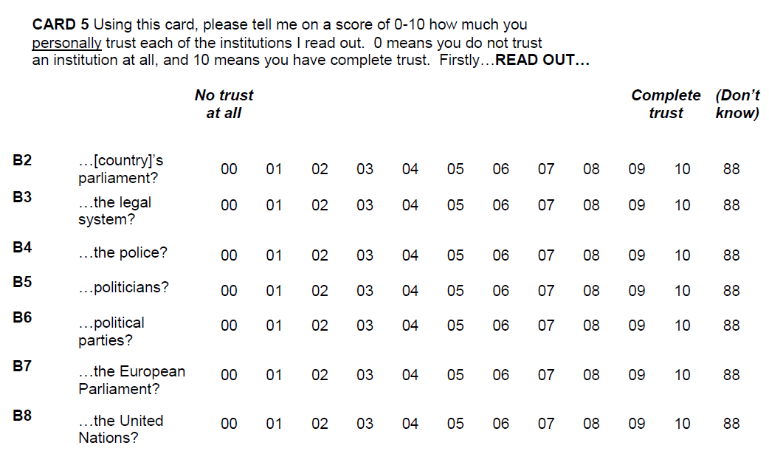
European Social Survey 2012/13 (Questions B2 – B8)
CAPI/CATI: No variable names

Slide 23
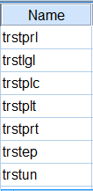
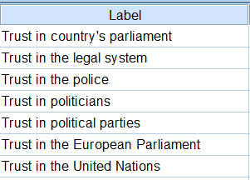
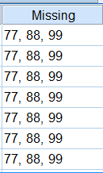
European Social Survey 2012 (Questions B2 – B8)
Mnemonic
names
No question numbers in labels
(Python can’t help)
High values:
useful for giving spurious values if not declared
[Variable names are constant across all waves]

Slide 24
Relative Deprivation and Social Justice
Survey: 1962-63 (Research Services Ltd) Book: W G Runciman Relative Deprivation and Social Justice (RKP 1966) Data: Relative Deprivation and Social Justice 1966 UKDS SN 28
Created 1975 by Dr Annette Scambler, Sociology, Surrey:
fully restored 2014 by John Hall
(long of memory tooth as well as of tooth!)
Commentaries:
SN28 Commentary on Relative Deprivation and Social Justice
SN28 Appendix 1 - Download of original data from UKDS
SN28 Appendix 4 - Annette Scambler's 1975 version

Slide 25
SSRC Survey Unit Multi-purpose survey (1975) (UKDS: SN 680)
Commentary on Multi-purpose 1975
(which takes us almost full circle to file design conventions designed at the SSRC Survey Unit and used by my then research trainee, the late Cathie Marsh, for this survey)

Slide 26
The End
. . but these two got squeezed out in 2006 so, even though there’s more to follow:

Slide 27
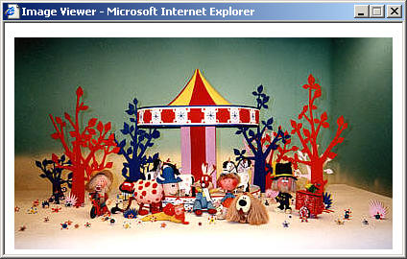
Time for tea…
Copyright BBC

Slide 28
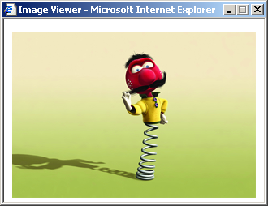
…and you can’t do that in syntax!
…said Zebedee
Copyright © 2002 Pathe Pictures

